Slide 1

3.1 Computer architecture
The common characteristics of CPUs

Slide 2

Factors affecting speed

Slide 3
Factors affecting speed
Power of the engine

Slide 4
Factors affecting speed
Power of the engine
Tyres

Slide 5
Factors affecting speed
Power of the engine
Tyres
Weather conditions

Slide 6
Factors affecting speed
Power of the engine
Tyres
Weather conditions
Driver’s skill

Slide 7
Factors affecting speed
Power of the engine
Tyres
Weather conditions
Driver’s skill
Aerodynamics

Slide 8


How common characteristics of CPUs affect their performance
Clock
Speed measured in hertz (Hz), number of cycles per second.
Modern processors operate at billions of cycles per second – or gigahertz (GHz).
3.2 GHz clock speed = 3.2 billion instructions fetched per second.
Clock speed

Slide 9
How common characteristics of CPUs affect their performance
Cache
Temporary storage of data and instructions being read to and written from.
Located on or near the CPU.
Stores copies of recent data and instructions.
Much quicker to access than main memory (RAM).
Clock speed
Cache size

Slide 10
How common characteristics of CPUs affect their performance
Cores
In very simple terms, a core is a complete copy of a CPU.
A quad-core processor would have four separate processing units, each with its own:
Registers
ALU
Accumulator
Control unit, etc.
CPUs with multiple cores have more power to run multiple programs at the same time.
Clock speed
Cache size
Number of cores

Slide 11
How common characteristics of CPUs affect their performance
Cores
Doubling the number of cores doesn’t simply double the overall speed.
CPU cores communicate with each other, which takes time.
Many programs are not designed to make use of multiple cores.
Clock speed
Cache size
Number of cores

Slide 12

Common characteristics of the CPU
A CPU’s overall performance can be affected by several factors. The three most important factors are:
Clock speed
Measured in number of cycles per second or hertz (Hz).
3.2GHz clock speed = 3.2 billion instructions fetched per second – in theory.
Cache size
Temporary storage of data and instructions being read from and written to main memory (RAM).
Stores copies of recent data and instructions.
Much quicker to read from than main memory (RAM).
Reduces the need to fetch instructions and data from memory, saving time.
Number of cores
A core is a complete copy of a CPU.
A quad-core processor has four separate processing units, each with its own registers, ALU, accumulator and CU.
Doubling the number of cores won’t double processing speed. Cores need to communicate with each other, which takes time. Many programs are not designed to make use of multiple cores.

Slide 13

3.1 Computer architecture
Going beyond the IGCSE specification

Slide 14
Multicore systems

Slide 15
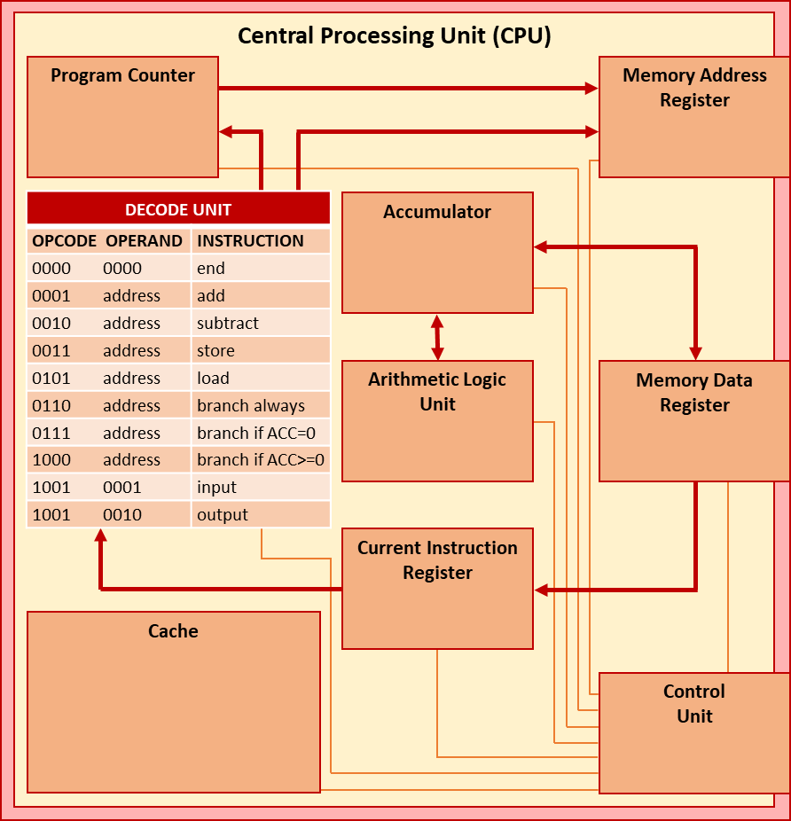
Multicore systems
Chip multiprocessor (CMP)
Houses four CPU cores.
Commonly referred to as a quad-core processor.
Shared cache

Slide 16


Multicore systems
Chip multiprocessor (CMP)
Houses four CPU cores.
Commonly referred to as a quad-core processor.
Additional specialised processing units
Often found on other devices plugged into the motherboard such as a graphics or sound card.
Contain specialised processors that help offload tasks from the main CPU, improving overall performance.
Shared cache

Slide 17


